Slide 1
Introduction to Deep Learning: from linear regression to AlexNet.
Ruben Sanchez Garcia
March 2018

Slide 2
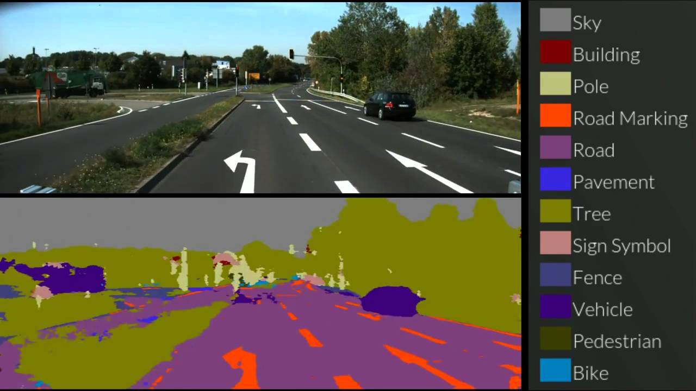
What is Deep Learning?

Slide 3
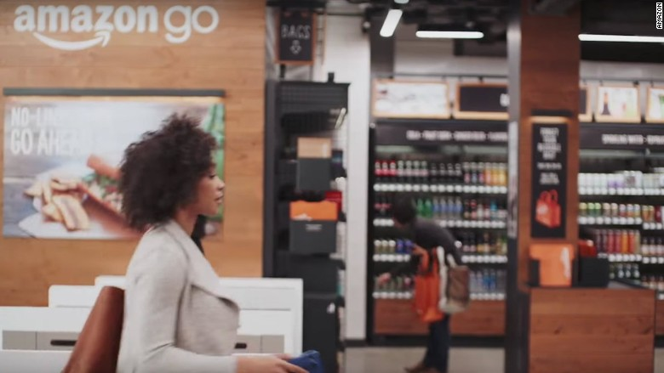
What is Deep Learning?

Slide 4
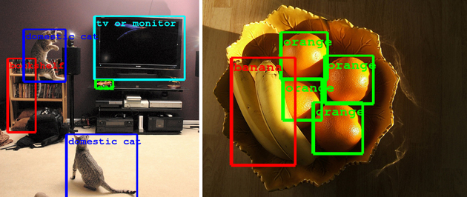
What is Deep Learning?

Slide 5
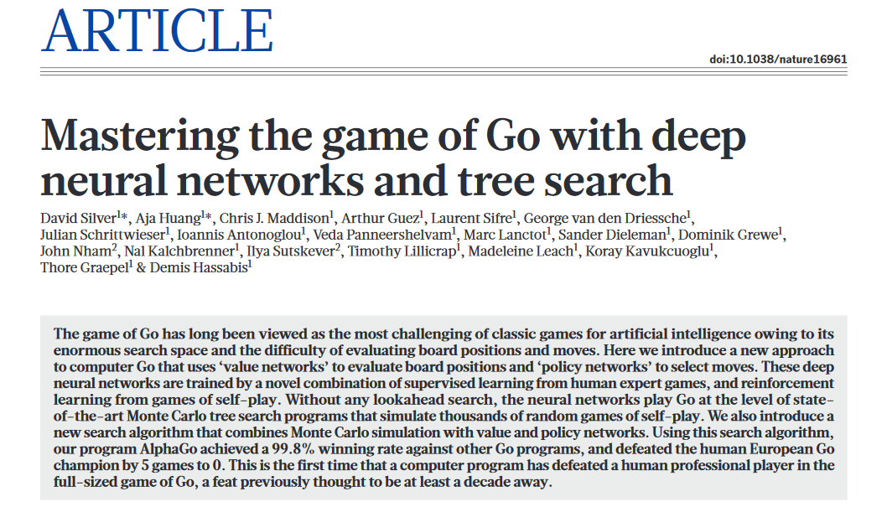
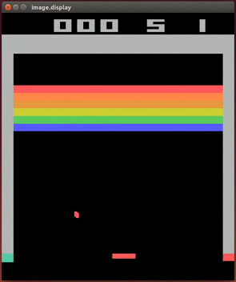
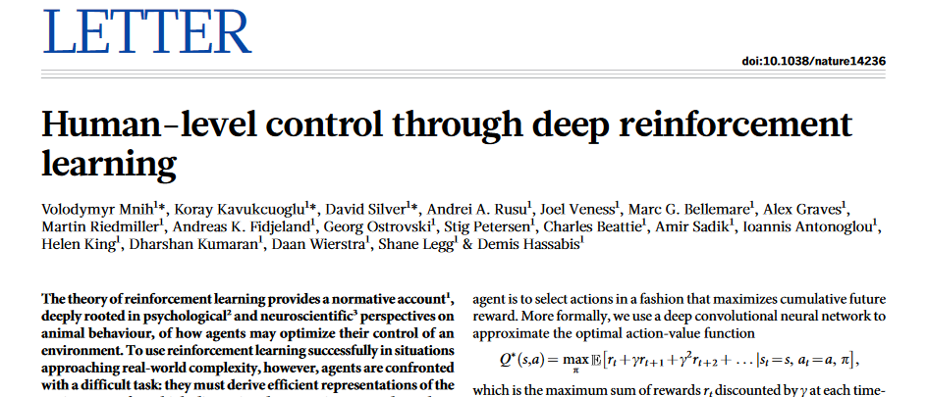
What is Deep Learning?

Slide 6
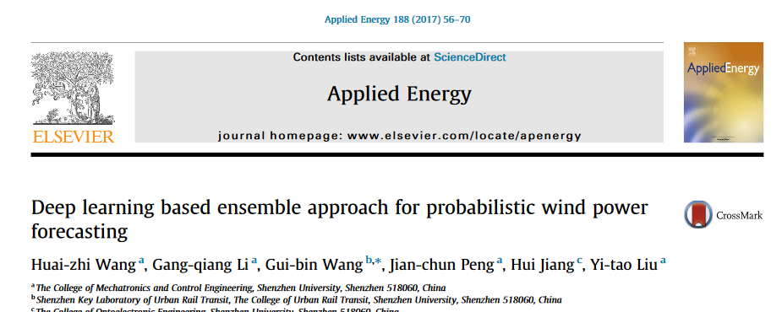
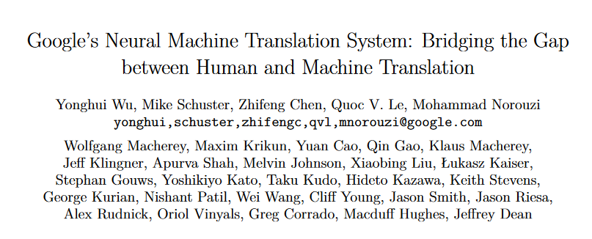
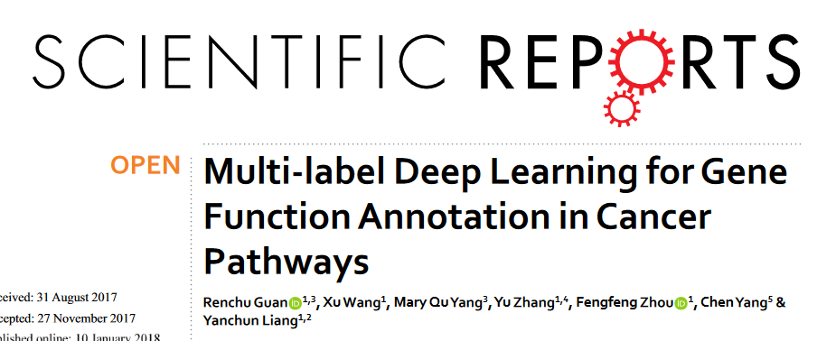
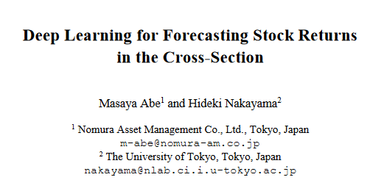
What is Deep Learning?

Slide 7
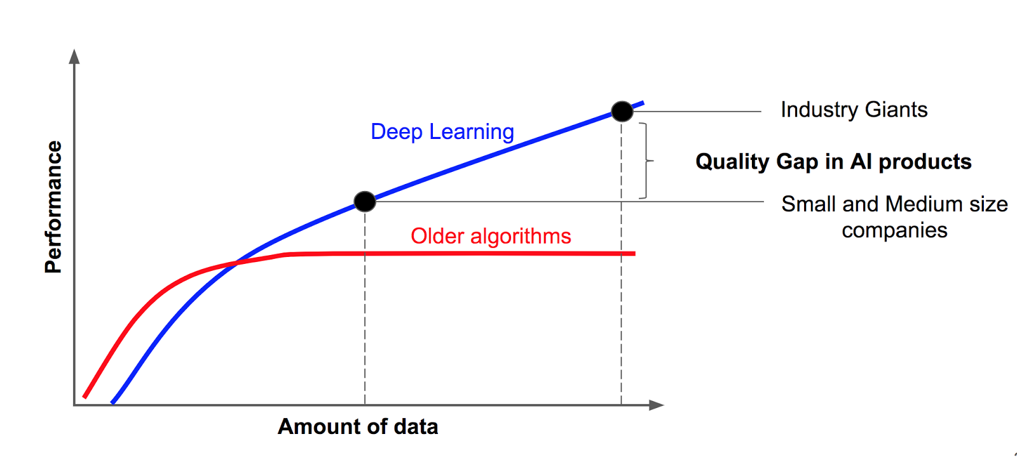
What is Deep Learning?
It is a machine learning subfield based on deep artificial neural networks.
Contrary to regular machine learning, no feature engineering is needed.
Tons of data are needed.

Slide 8
What is Machine Learning?
It is an Artificial Intelligence field that aims to achieve intelligent systems that “learn” from data without the need of explicit programming.
Learning what? To solve a task.

Slide 9
Tasks that can be “learned”
Supervised Learning:
Training data: data points and label
We want to predict labels associated to that points (mapping).
Labels can be numerical o categorical.
Unsupervised Learning:
No training data
We have data points and no labels and we want to draw conclusions from them.
Clustering

Slide 10
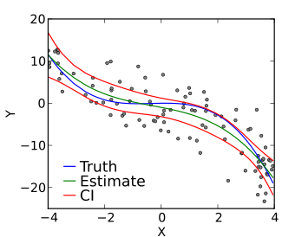
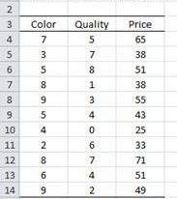
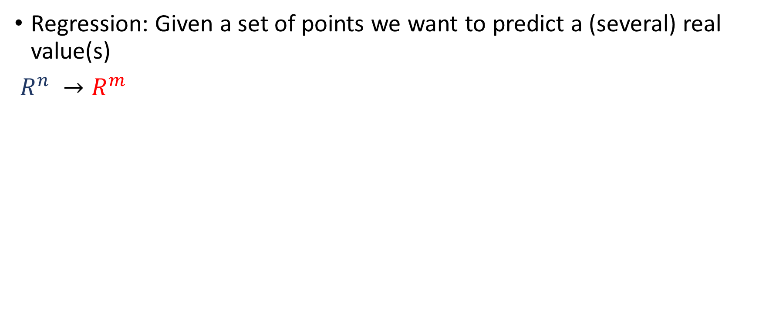
Supervised tasks that can be “learned”
Regression: Given a set of points we want to predict a (several) real value(s)
$R^{n} →R^{m}$
Features
Labels

Slide 11
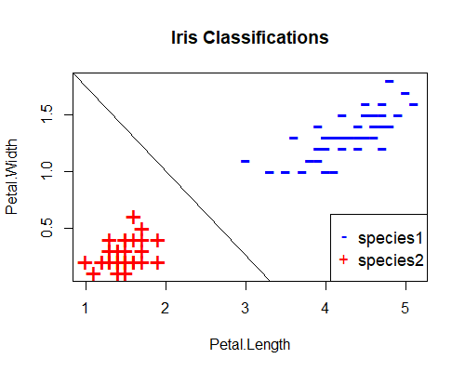
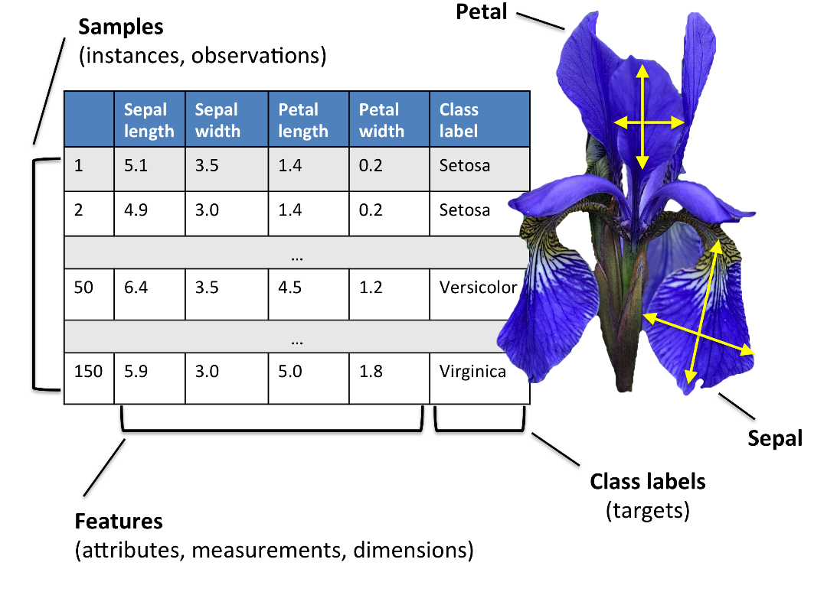
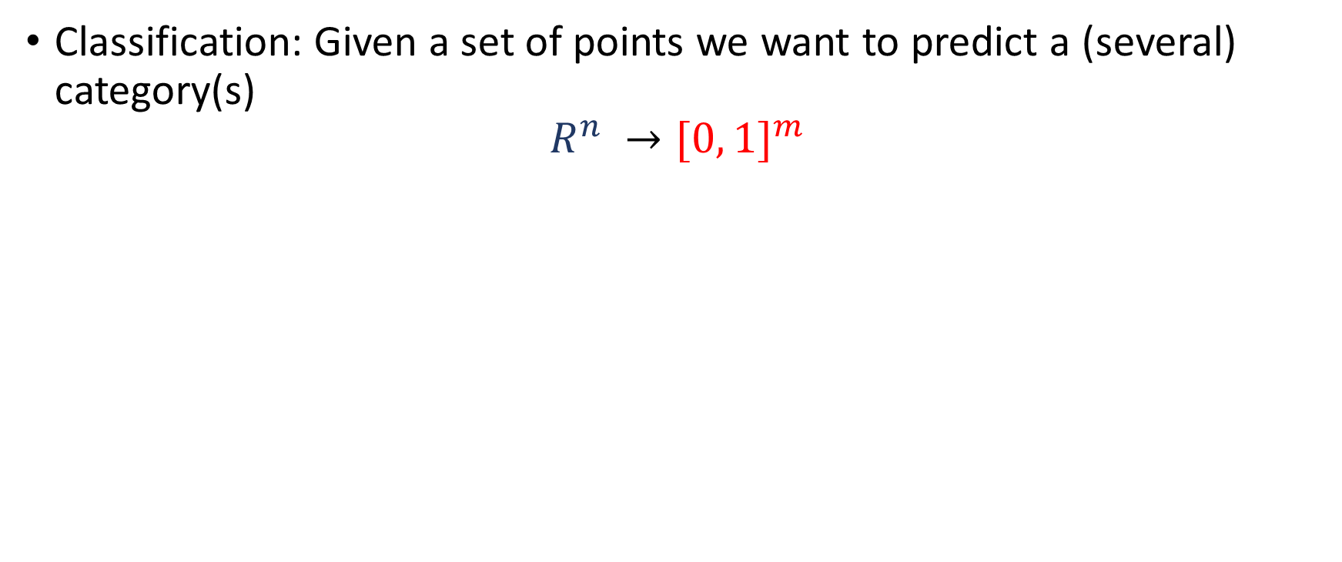
Supervised tasks that can be “learned”
Classification: Given a set of points we want to predict a (several) category(s)
$$R^{n} →{[0, 1]}^{m}$$

Slide 12
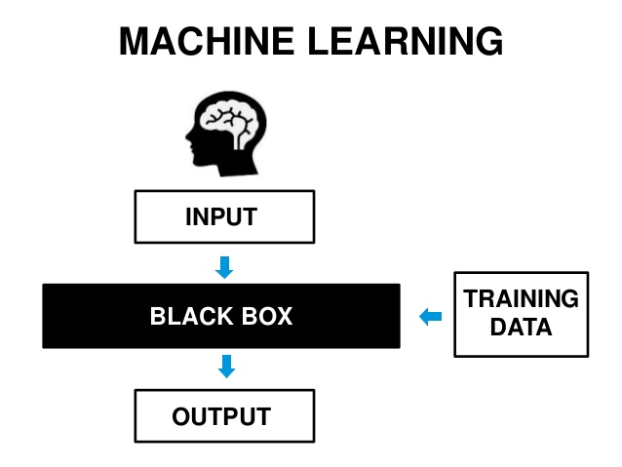
Some people view of supervised machine learning

Slide 13
My personal view of supervised machine learning
You do not to know how the algorithm works, but, you need to know how to set its hyper-parameters properly. Depending on them, your model will be prone to either overfitting or underfitting. Your task will be to choose the hyper-parameters such that the model exhibits no underfitting nor overfitting (ideally).
SEMI-TRANSPARENT BOX

Slide 14
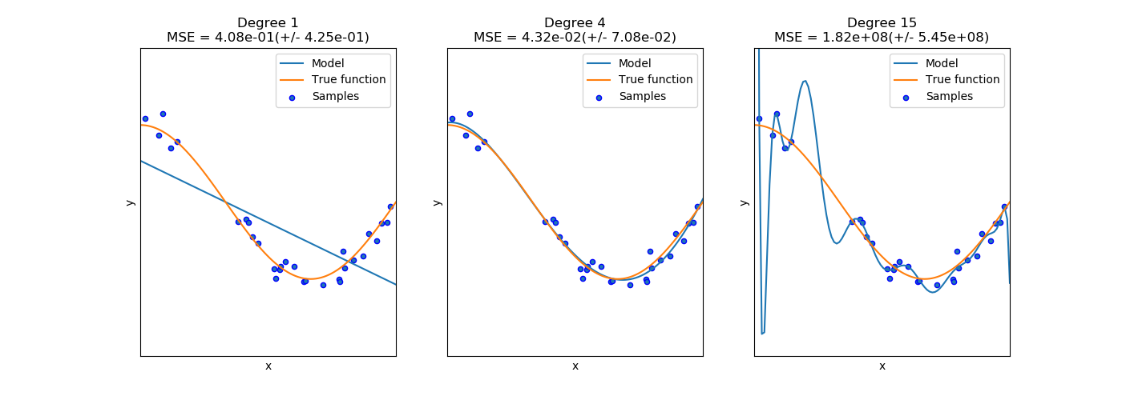
Underfitting and overfitting

Slide 15
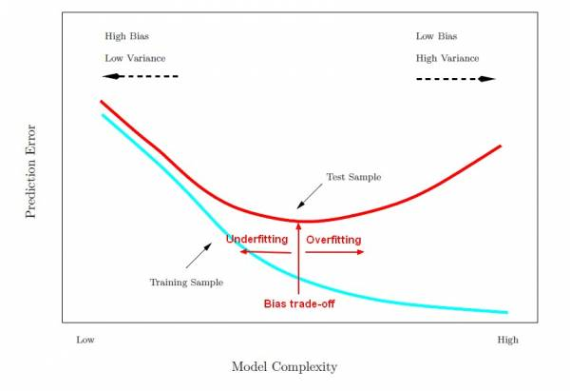
Underfitting and overfitting
In order to select proper hyper-parameters you should detect if your model is in the overfitting zone or in the underfitting zone:
Split your data into 3 parts: training data set, test data set and validation data set (e.g. 70% 20% and 10%) or do cross-validation.
Compare error on training set with error on test set.
If your training error is low and the test error is high → overfitting
If your training error is high → underfitting

Slide 16
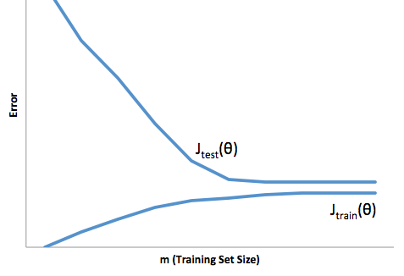
Underfitting and overfitting
If the training error oscillates as crazy:
Decrease learning rate (α)
If you are in:
Underfitting regime | Overfitting regime
Make your model more complex (p.e. increase the degree of the polynomial, more or bigger layers in neural net) | Make your model less complicate (decrease the degree of the polynomial, less layers or smaller in neural net
Look for new variables/ feature engineering | Get more training data
Decrease regularization strength | Apply regularization techniques
Tune hyper-parameters to make your model fit better your data | Tune hyper-parameters to make your model fit worse your data

Slide 17
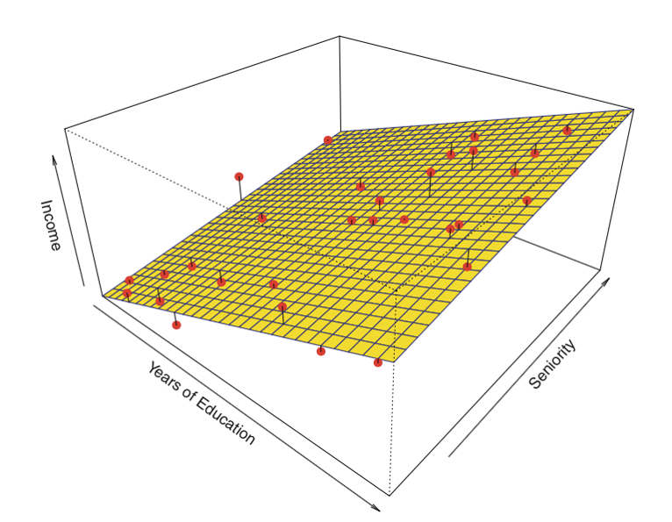
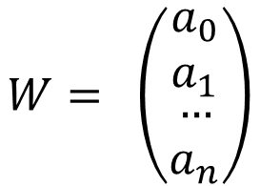
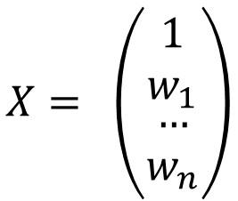
Easiest model: Linear regression.
$$X= \left(\begin{matrix}1 \\ w_{1} \\ \begin{matrix}… \\ w_{n}\end{matrix}\end{matrix}\right)$$
$$y(x_{1}, x_{2},…, x_{n})=w_{0}+w_{1}x_{1}+w_{2}x_{2}+…+w_{n}x_{n}=W^{T}X$$
$$W= \left(\begin{matrix}a_{0} \\ a_{1} \\ \begin{matrix}… \\ a_{n}\end{matrix}\end{matrix}\right)$$
Example number | Years of Education | Seniority | Income
1 | 2 | 2 | 24000
2 | 4 | 4 | 37000
… | … | … | …
N | 6 | 1 | 31000

Slide 18
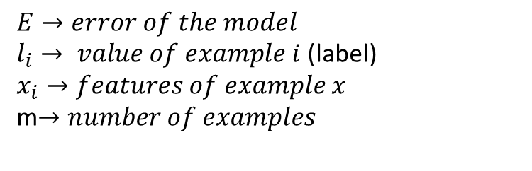
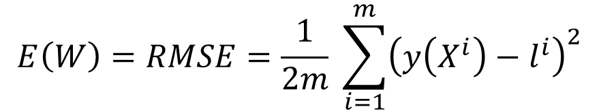
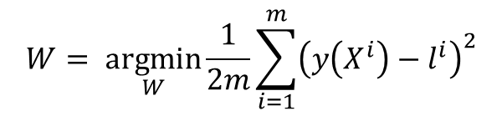
Easiest model: Linear regression.
$$X= \left(\begin{matrix}1 \\ w_{1} \\ \begin{matrix}… \\ w_{n}\end{matrix}\end{matrix}\right)$$
$$y(x_{1}, x_{2},…, x_{n})=w_{0}+w_{1}x_{1}+w_{2}x_{2}+…+w_{n}x_{n}=W^{T}X$$
$$W= \left(\begin{matrix}a_{0} \\ a_{1} \\ \begin{matrix}… \\ a_{n}\end{matrix}\end{matrix}\right)$$
$$E\left(W\right)=RMSE=\frac{1}{2m} \sum_{i=1}^{m}{{\left(y\left(X^{i}\right)−l^{i}\right)}^{2}}$$
$E→error of the model$
$l_{i}→ value of example i$ (label)
$$x_{i}→features of example x$$
m$→number of examples$
Find W such that E(W) is minimum
$$W= \underset{W}{argmin}{\frac{1}{2m}\sum_{i=1}^{m}{{\left(y\left(X^{i}\right)−l^{i}\right)}^{2}}}$$

Slide 19
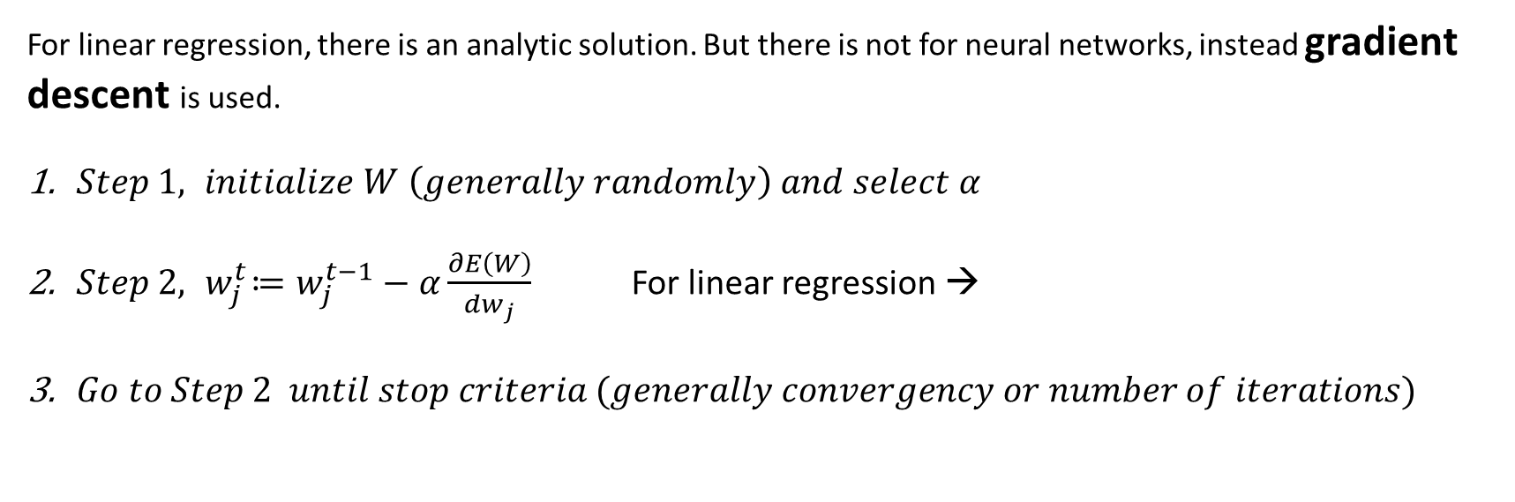
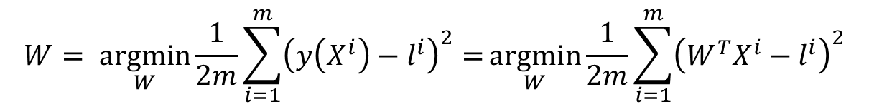
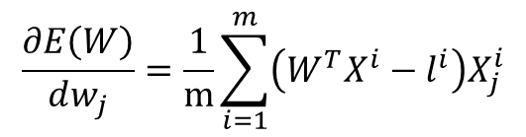
Easiest model: Linear regression.
$$W= \underset{W}{argmin}{\frac{1}{2m}\sum_{i=1}^{m}{{\left(y\left(X^{i}\right)−l^{i}\right)}^{2}=}}\underset{W}{argmin}{\frac{1}{2m}\sum_{i=1}^{m}{{\left(W^{T}X^{i}−l^{i}\right)}^{2}}}$$
Find W such that E(W) is minimum
For linear regression, there is an analytic solution. But there is not for neural networks, instead gradient descent is used.
$Step 1, initialize W \left(generally randomly\right) and select α$
$Step 2, { w}_{j}^{t}≔w_{j}^{t−1}−α\frac{∂E\left(W\right)}{dw_{j}}$ For linear regression →
$Go to Step 2 until stop criteria (generally convergency or number of iterations)$
$$\frac{∂E\left(W\right)}{dw_{j}}=\frac{1}{m}\sum_{i=1}^{m}{\left(W^{T}X^{i}−l^{i}\right)X_{j}^{i}}$$

Slide 20

Gradient descent

Slide 21
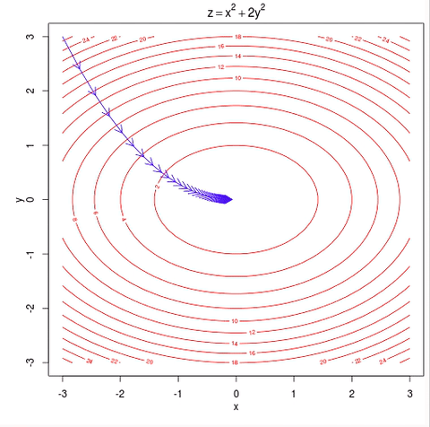
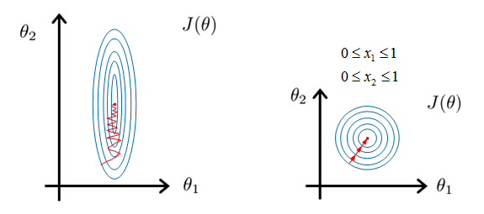
Gradient descent
Important:
Scale features before applying gradient descent (min-max normalization or mean-std normalization)
Choose learning rate α wisely.

Slide 22
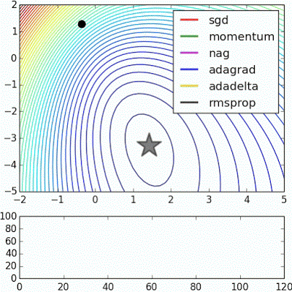
More advanced gradient descent

Slide 23
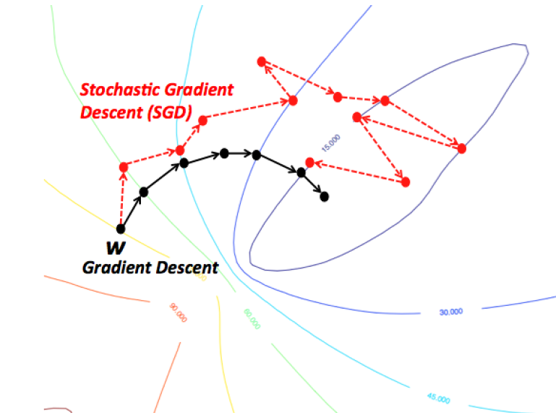
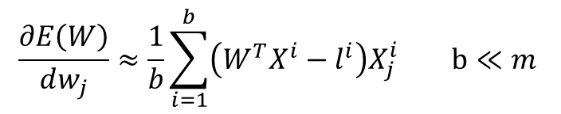
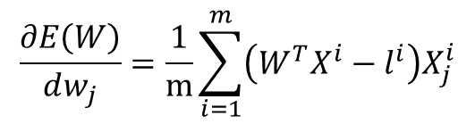
More advanced gradient descent: SGD
Instead of computing for the weights update
$$\frac{∂E\left(W\right)}{dw_{j}}=\frac{1}{m}\sum_{i=1}^{m}{\left(W^{T}X^{i}−l^{i}\right)X_{j}^{i}}$$
Use an estimation computed with a random sample of training examples. This random sample is named batch of training examples.
$$\frac{∂E\left(W\right)}{dw_{j}}≈\frac{1}{b}\sum_{i=1}^{b}{\left(W^{T}X^{i}−l^{i}\right)X_{j}^{i} \text{b}≪m }$$
And apply the regular gradient algorithm. It is generally convenient to slowly decrease learning rate as the number of iterations grows.

Slide 24
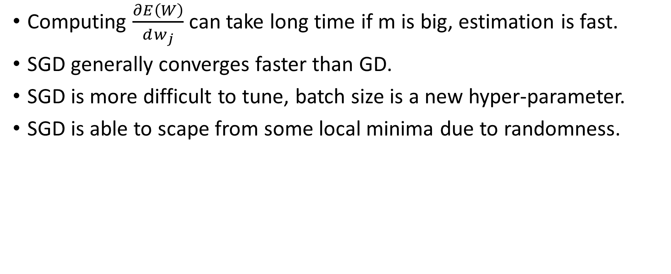
SGD vs GD
Computing $\frac{∂E\left(W\right)}{dw_{j}}$ can take long time if m is big, estimation is fast.
SGD generally converges faster than GD.
SGD is more difficult to tune, batch size is a new hyper-parameter.
SGD is able to scape from some local minima due to randomness.

Slide 25
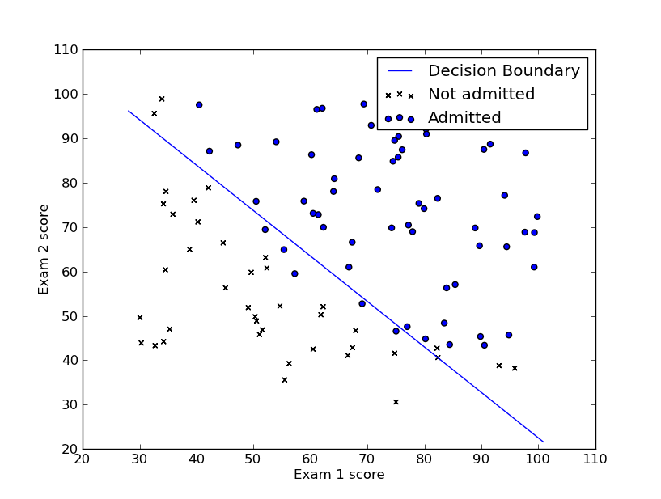
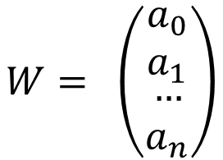
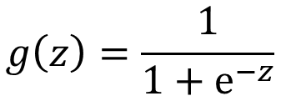
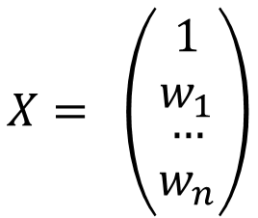
Easiest model for classification: Logistic regression. We are close to neural nets, I promise
$$W= \left(\begin{matrix}a_{0} \\ a_{1} \\ \begin{matrix}… \\ a_{n}\end{matrix}\end{matrix}\right)$$
$$y(x_{1}, x_{2},…, x_{n})={g( w}_{0}+w_{1}x_{1}+w_{2}x_{2}+…+w_{n}x_{n})=\frac{1}{1+e^{−W^{T}X}}$$
$$g\left(z\right)=\frac{1}{1+e^{−z}⁡}$$
$$X= \left(\begin{matrix}1 \\ w_{1} \\ \begin{matrix}… \\ w_{n}\end{matrix}\end{matrix}\right)$$
Example number | Exam 1 score | Exam 2 score | Admitted
1 | 20 | 20 | 0
2 | 40 | 90 | 1
… | … | … | …
N | 60 | 60 | 1

Slide 26
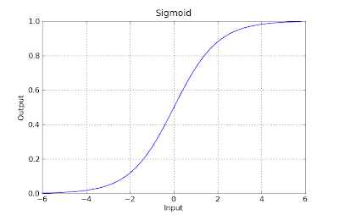
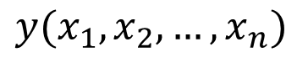
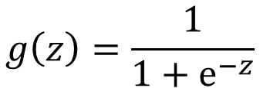
Easiest model for classification: Logistic regression.
Can be interpreted as the probability that a given example will belong to the category 1 $P\left(y=1 \right| X, W)$
$$y(x_{1}, x_{2},…, x_{n})$$
In order to get categorical predictions, a decision threshold must be set. If no prior information 0.5 is chosen.
$$g\left(z\right)=\frac{1}{1+e^{−z}⁡}$$

Slide 27
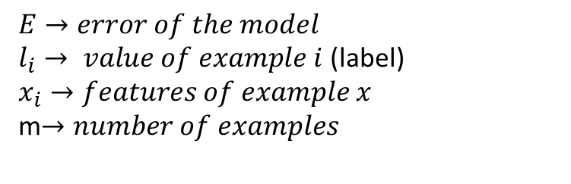
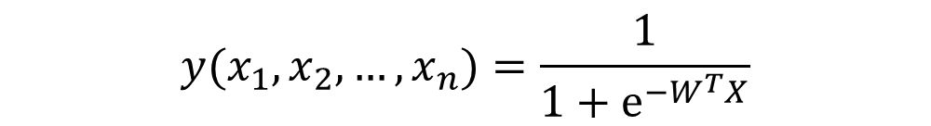
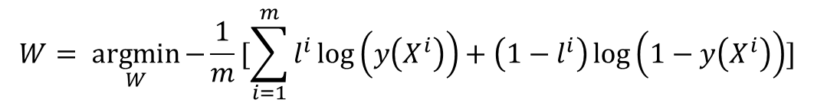
Easiest model for classification: Logistic regression.
$$y(x_{1}, x_{2},…, x_{n})=\frac{1}{1+e^{−W^{T}X}}$$
$$E\left(W\right)=cross−entropy=−\frac{1}{m}[\sum_{i=1}^{m}{l^{i}\log\left(y\left(X^{i}\right)\right)+\left(1−l^{i}\right)\log\left(1−y\left(X^{i}\right)\right)]}$$
$E→error of the model$
$l_{i}→ value of example i$ (label)
$$x_{i}→features of example x$$
m$→number of examples$
Find W such that E(W) is minimum
$$W= \underset{W}{argmin}{−\frac{1}{m}[\sum_{i=1}^{m}{l^{i}\log\left(y\left(X^{i}\right)\right)+\left(1−l^{i}\right)\log\left(1−y\left(X^{i}\right)\right)]}}$$

Slide 28
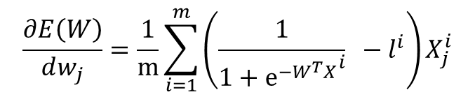
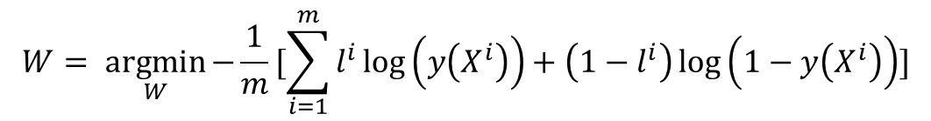
Easiest model for classification: Logistic regression.
$$W= \underset{W}{argmin}{−\frac{1}{m}[\sum_{i=1}^{m}{l^{i}\log\left(y\left(X^{i}\right)\right)+\left(1−l^{i}\right)\log\left(1−y\left(X^{i}\right)\right)]}}$$
To obtain W, use gradient descent as before. For cross entropy with sigmoid activation, the derivative of the error is:
$$\frac{∂E\left(W\right)}{dw_{j}}=\frac{1}{m}\sum_{i=1}^{m}{\left(\frac{1}{1+{e^{−W^{T}X}}^{i}} −l^{i}\right)X_{j}^{i}}$$

Slide 29
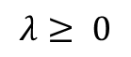

A simple way to diminish overfitting: regularization
Add a regularization term to the error function. This term will prevent weights from growing to much, constraining the model.
$$E\left(W\right)=−\frac{1}{m}[\sum_{i=1}^{m}{l^{i}\log\left(y\left(X^{i}\right)\right)+\left(1−l^{i}\right)\log\left(1−y\left(X^{i}\right)\right)]+λ\sum_{j=1}^{n}{w_{j}^{2}}}$$
$$λ≥ 0$$

Slide 30

ARTIFICIAL NEURAL NETWORKS

Slide 31

Deep learning history
AlexNet
Deep Learning become trendy
2012
VGG-net
Inception
ResNet
U-net…

Slide 32

Deep learning history
1940- 1950. Neurons as weighted sum of inputs thresholded
1950-1960. Perceptron as combinations of several neurons. Still no perfect algorithm to train them
1969. Perceptron can not learn the XOR function. Neural net research became minoritarian for 15 years.
1980- 1990. Multilayer perceptron and back propagation. The root of modern neural networks.
1998. Convolutional networks were invented. LeNet.
2006 – 2012. Neural networks field was renamed to Deep Learning when Deep Networks were able to be trained by layer-wise pretraining.
2012-now. AlexNet showed that direct training of Deep Convolutional Networks was possible and they perform better than any other known method. Deep Learning age.

Slide 33


Multilayer Perceptron
Also called fully connected networks.
At least three layers:
Input layer. As many units as dimensions the input have
Hidden layer(s).
As many hidden layers as desired with as many neurons as desired. Each neuron is equivalent to an individual logistic regression.
Each neuron of a hidden network is connected with all the neurons of the previous and the next layers.
Output layer . As many units neurons as dimensions the ouput have. For classification, softmax is generally applied in order to normalize probabilities.
$$s\left(z_{j}\right)=\frac{e^{z_{j}}}{\sum_{k=1}^{K}{e^{z_{k}}}}$$

Slide 34


Multilayer Perceptron (MLP)
Trained by gradient descent (better SGD).
The gradient of the error, needed for gradient descent is calculated by means of back-propagation, which it is nothing but the use of the calculus chain rule.
In back propagation, first a output for a sample is computed (forward pass)
Then the error is back-propagated

Slide 35

Multilayer Perceptron (MLP)
Generally, weights are random initialized using a Gaussian distribution (0,0.1)
Training a deep MLP is generally no so easy, as logistic functions can saturate.
Use other activation function.
MLPs have so many parameters that they tend to overfit.
Inspect learning curves and use early stopping
Use regularization
Other tricks we will discuss later.

Slide 36

The first convolutional network: LeNet
As there are substructure in images (a path of an image is still an image, and neighbor pixels are related) fully connected architectures are not needed to analyze them.
Instead use locally connected networks that inspect patches instead the full image → equivalent to convolution.

Slide 37


The first convolutional network: LeNet

Slide 38


The origin of modern Deep Learning: AlexNet
AlexNet won 2012 ImageNet competition (1000 thousand categories several millions images) lowering error to 15.4 % (second best error was 26.2%). No neural net won ImageNet until AlexNet. From now on, Deep Learning solutions have always won the conquest.

Slide 39

The origin of modern Deep Learning: AlexNet
AlexNet is a convolutional neural network of 5 convolution layers combined with max-pooling and a final 2 fully connected layer-classifier.
They employ revolutionary tricks that changed the field, such as:
Data augmentation
Stochastic gradient descent trained on GPU
ReLU as activation function (no need layer wise pretraining)
Dropout

Slide 40


The origin of modern Deep Learning: AlexNet
Relu. Makes training easier an faster as it does not saturate
Dropout: Regularization technique. Use it if you have overfitting

Slide 41


Other famous Neural Nets and tricks
Neural Nets:
VGG net. Pretty simple convNet of 16 layers that employs only 3x3 filter size. Several convs before max pooling.
Google Net (Inception). It won ImageNet 2014. Very complicated convNet with branches.
ResNet. It won ImageNet 2015. Similar to VGG net but with skipping connections.
Faster R-CNN. Used to localize objects in images, not to classify full images.
LSTMs. Recurrent networks suited for sequence analysis.
Generative Adversarial Networks. One network is train to classify and other to confuse the first network.
…
Tricks:
Batch Normalization.
1d convolution.
Residuals (skipping connections).
Fully convolution networks for image segmentation.
…

Slide 42
To be continued….
Practical examples with Tensorflow and Keras
Modern architectures and tricks: INCEPTION, RESNET, batch normalization…
Deep Learning for other than classification tasks: image segmentation, time series analysis, clustering…
Suggested topics …
or not?

